Slide 1
Endocrine Control of Growth
Notes:
----- Meeting Notes (10/16/15 10:18) -----
PKA responses to adrenaline/glucagon
alpha receptor sensitization cortisol

Slide 2
Learning Objectives
List the hormones important for growth at key times in a person's life.
Describe the functions of human growth hormone on growth (bones and soft tissues), and on metabolism, and the regulation of its secretion. Explain what 'rhGH' means.
State the "dual effector hypothesis" for GH actions, and the relative roles of GH and IGF-1 in growth control.
Describe the interactions among all the key growth-regulating hormones at key times of a person's life: in utero, neonatally, childhood, puberty, adulthood, and senescence.
Describe the daily regulation of GH levels and the physiological relevance of these cycles.

Slide 3
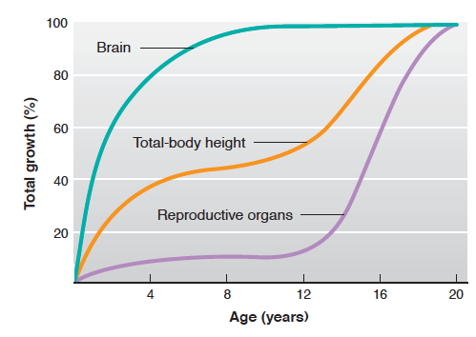
Human Organ Growth

Slide 4
Hormones During Growth
Stage | Age | Hormonal Requirements
Prenatal | (9 months) | Insulin
Infantile | 0-1 | Insulin
Juvenile | 1-12 years | GH, Insulin, T3, Vitamin D
Adolescent (Pubertal) | 10-14 (F) 12-16 (M) | GH, insulin, T3, Vitamin D and Sex Steroids
Adult | Puberty – 100 | Normally limited growth

Slide 5
Growth Hormone Summary
What chemical type is it? | Protein
Where is it made? | Somatotropes of Anterior Pituitary
What causes its release? | GHRH release (also regulated by somatostatin)
What is its receptor? | Growth Hormone Receptor | JAK/STAT
What tissues does it affect? | Liver | IGF-1 Release
 | Bones | Growth
 | Muscle | Protein Synthesis
 | Adipose Tissue | Lipolysis
How does it get turned off? | IGF Negative Feedback to Pituitary and Hypothalamus. GH/IGF1 Stimulation of somatostatin and receptor desensitization

Slide 6
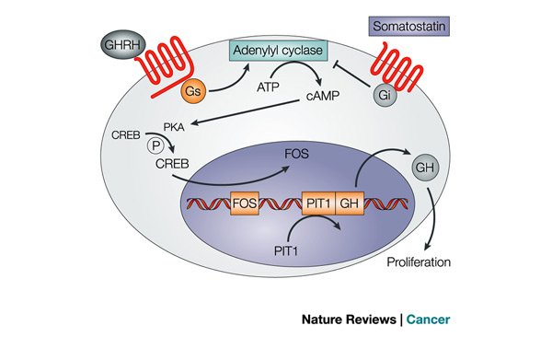
Regulation of GH Release

Slide 7
GH Decreases with Aging
Talk amongst yourselves about some possible mechanisms by which this could happen?
Less GH synthesis
Less GHRH responsiveness
Less GHRH synthesis
More SST synthesis
More SST responsiveness
Notes:
Less GH synthesis
Less GHRH responsiveness
Less GHRH synthesis
More SST synthesis
More SST responsiveness

Slide 8
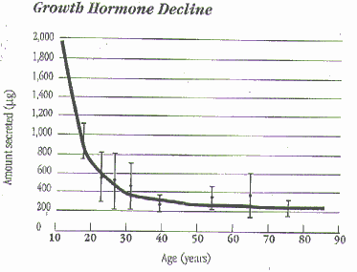
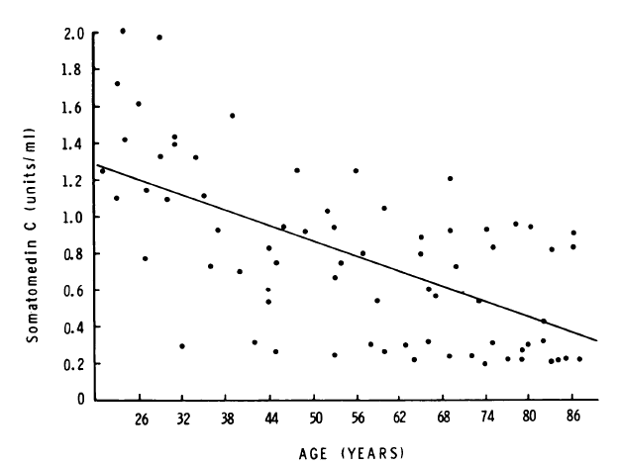
GH and Aging
GHRH Levels
Rudman D, Kutner MH, Rogers CM, Lubin MF, Fleming G a., et al. (1981) Impaired growth hormone secretion in the adult population. Relation to age and adiposity. J Clin Invest 67: 1361–1369. doi:10.1172/JCI110164.

Slide 9
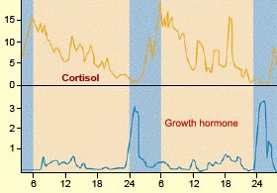
Diurnal Rhythms of GH Release
Notes:
Discuss advantages of GH peaking at night

Slide 10
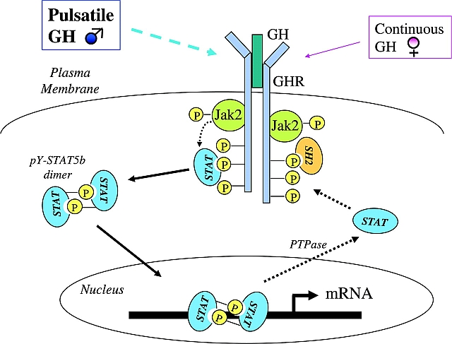
Growth Hormone Receptor

Slide 11
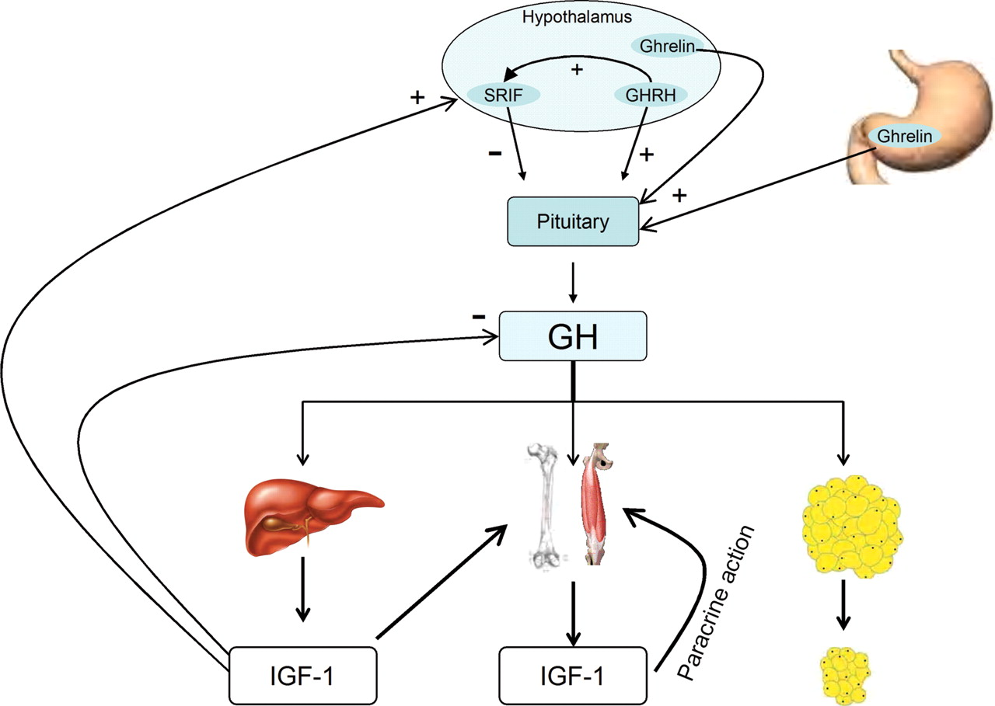
Growth Hormone Causes IGF-1 Release

Slide 12
IGF-1 Summary
What chemical type is it? | Protein
Where is it made? | Liver
What causes its release? | GH Signaling
What is its receptor? | IGF1R | Receptor Tyrosine Kinase
What tissues does it affect? | Liver | IGF-1 Release
 | Bones | Chondrocyte replication
 | Muscle | Protein Synthesis
How does it get turned off? | Receptor desensitization, Less GH production, IGF-1 degradation

Slide 13
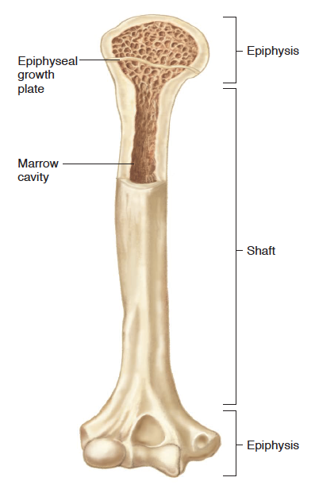
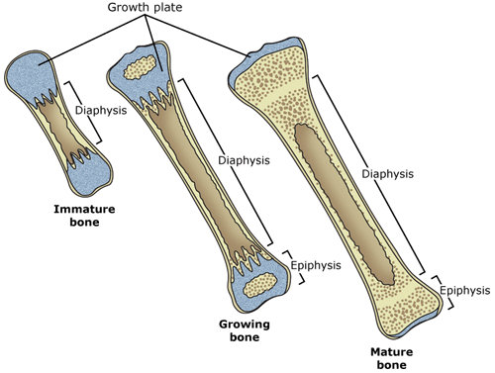
Regulation of Bone Growth

Slide 14
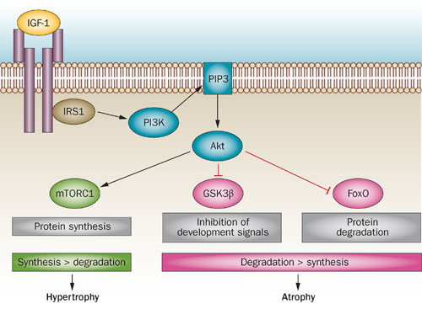
Regulation of Muscle Growth

Slide 15
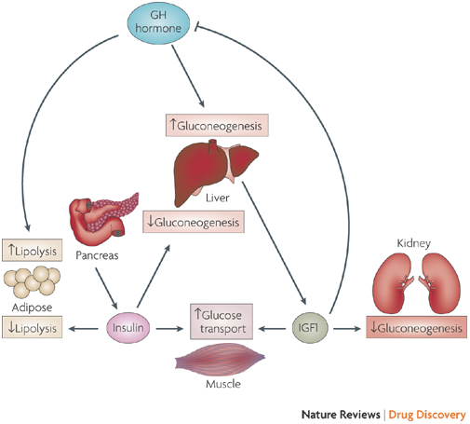
Effects of GH/IGF1 on Metabolism
Notes:
Dual efffector hypothesis

Slide 16
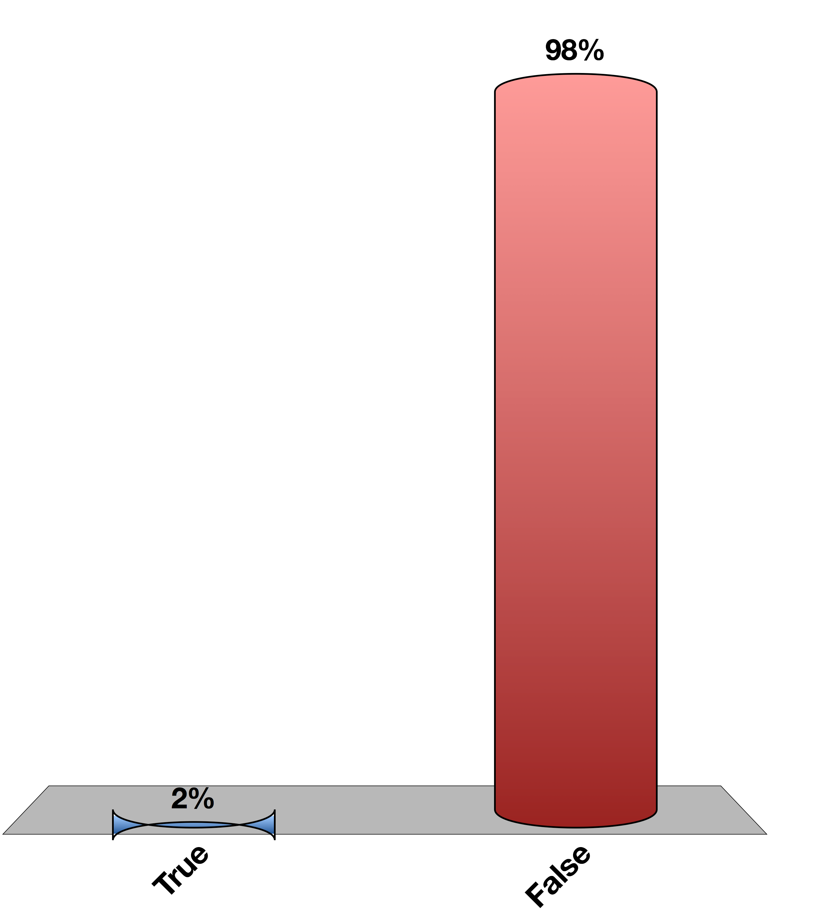
Can you recapitulate all the effects of GH by Providing IGF-1?
True
False
0
Notes:
Dual-effector hypothesis

Slide 17
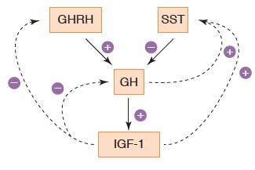
Negative Feedback of GH

Slide 18
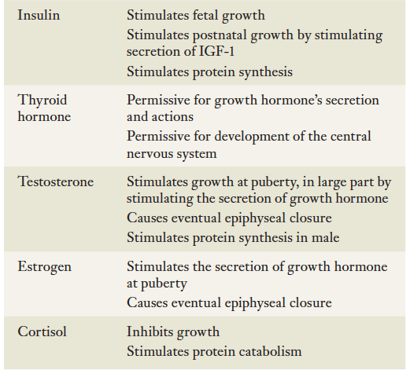
Other Hormones Influencing Growth

Slide 19
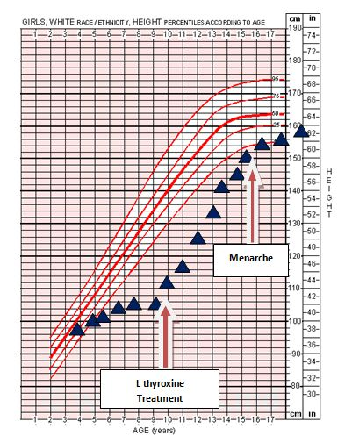
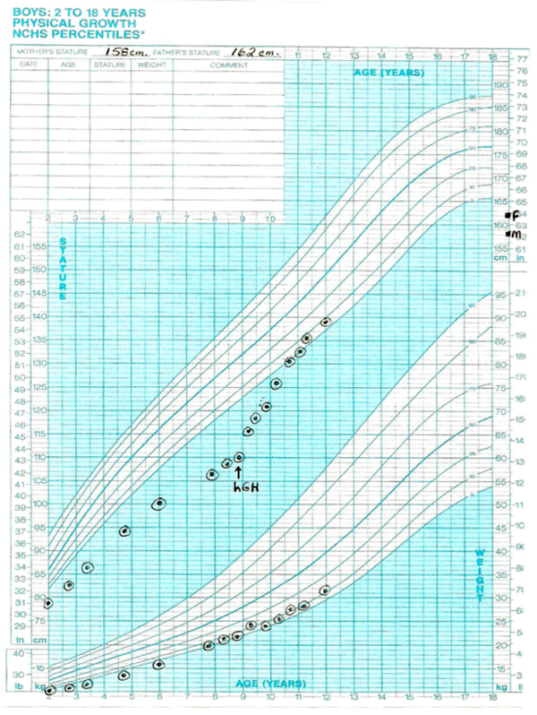
Treatment of Hypothyroidism

Slide 20
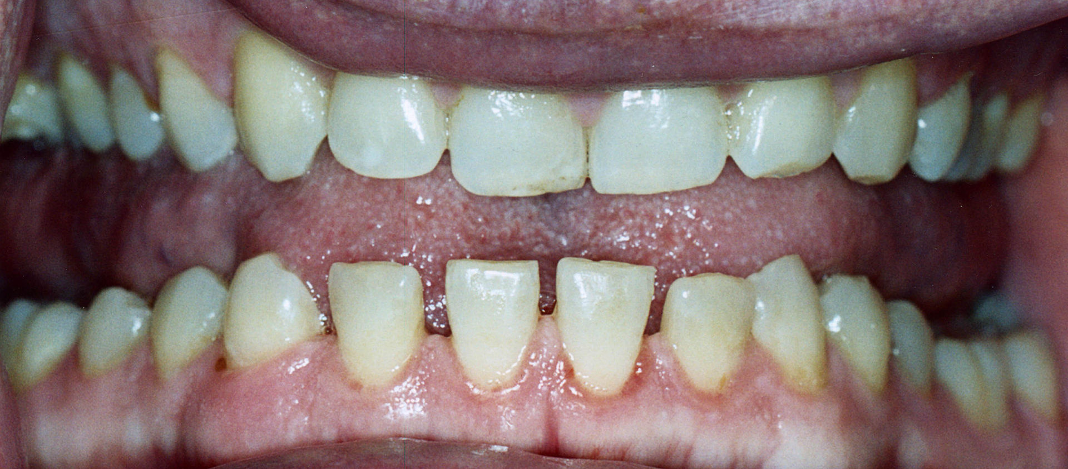
Acromegaly
Pituitary tumor of the somatotropes
Overproduction of GH
Clinical presentation
Bone growth
Protruding brow and jaw, spacing of teeth
Low body fat increased muscle
Insulin resistant/diabetic

Slide 21
Dwarfism/Growth Hormone Deficiency
Congenital or immune destruction of somatotropes
Can be GH deficiency or GH resistance
Can be secondary to hypothyroidism
Clinical features
Reduced height
Reduced muscle mass
Elevations in fat mass
Resistance to diabetes
Notes:
70% of cases are In the context of achondroplasia, this mutation causes FGFR3 to become constitutively active, inhibiting bone growth

Slide 22
Learning Objectives
List the hormones important for growth at key times in a person's life.
Describe the functions of human growth hormone on growth (bones and soft tissues), and on metabolism, and the regulation of its secretion. Explain what 'rhGH' means.
State the "dual effector hypothesis" for GH actions, and the relative roles of GH and IGF-1 in growth control.
Describe the interactions among all the key growth-regulating hormones at key times of a person's life: in utero, neonatally, childhood, puberty, adulthood, and senescence.
Describe the daily regulation of GH levels and the physiological relevance of these cycles.

